Slide 1
MATH-352 Numerical Methods
Atifa Kanwal
atifa.kanwal@seecs.edu.pk
Office # 303, Faculty Block, SEECS, NUST

Slide 2
Method of LU Factorization

Slide 3
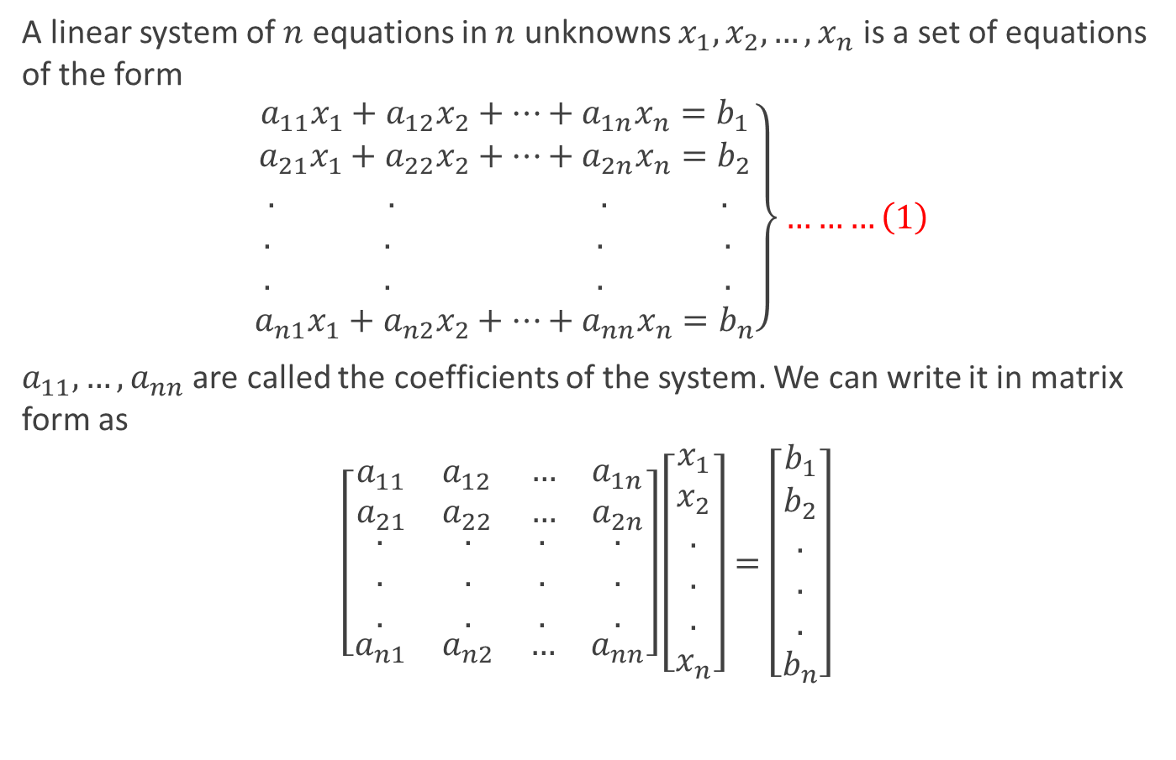
System of Linear Equations
A linear system of $n$ equations in $n$ unknowns $x_{1},x_{2},…,x_{n}$ is a set of equations of the form
$$\left.\begin{aligned}a_{11}x_{1}+a_{12}x_{2}+…+a_{1n}x_{n}=b_{1} \\ a_{21}x_{1}+a_{22}x_{2}+…+a_{2n}x_{n}=b_{2} \\ . . . . \\ . . . . \\ . . . . \\ a_{n1}x_{1}+a_{n2}x_{2}+…+a_{nn}x_{n}=b_{n}\end{aligned}\right\}………\left(1\right)$$
$a_{11},…,a_{nn}$ are called the coefficients of the system. We can write it in matrix form as
$$\left[\begin{matrix}\begin{matrix}a_{11} & a_{12} \\ a_{21} & a_{22}\end{matrix} & \begin{matrix}… & a_{1n} \\ … & a_{2n}\end{matrix} \\ \begin{matrix}\begin{aligned}. \\ . \\ .\end{aligned} & \begin{aligned}. \\ . \\ .\end{aligned} \\ a_{n1} & a_{n2}\end{matrix} & \begin{matrix}\begin{aligned}. \\ . \\ .\end{aligned} & \begin{aligned}. \\ . \\ .\end{aligned} \\ … & a_{nn}\end{matrix}\end{matrix}\right]\left[\begin{aligned}x_{1} \\ x_{2} \\ . \\ . \\ . \\ x_{n}\end{aligned}\right]=\left[\begin{aligned}b_{1} \\ b_{2} \\ . \\ . \\ . \\ b_{n}\end{aligned}\right]$$

Slide 4
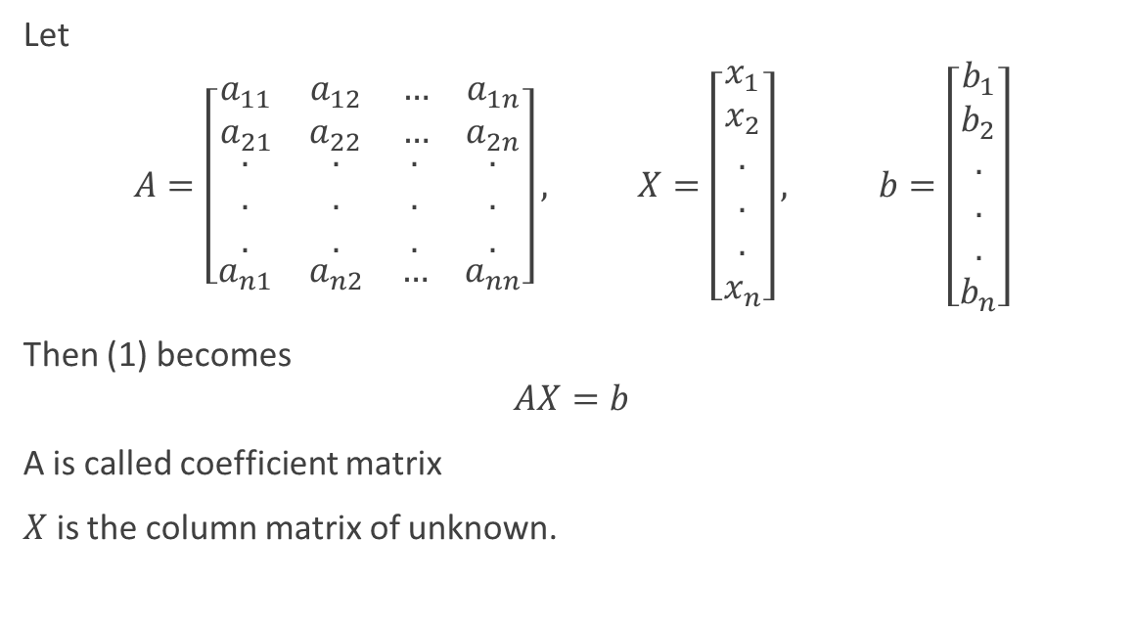
Let
$$A=\left[\begin{matrix}\begin{matrix}a_{11} & a_{12} \\ a_{21} & a_{22}\end{matrix} & \begin{matrix}… & a_{1n} \\ … & a_{2n}\end{matrix} \\ \begin{matrix}\begin{aligned}. \\ . \\ .\end{aligned} & \begin{aligned}. \\ . \\ .\end{aligned} \\ a_{n1} & a_{n2}\end{matrix} & \begin{matrix}\begin{aligned}. \\ . \\ .\end{aligned} & \begin{aligned}. \\ . \\ .\end{aligned} \\ … & a_{nn}\end{matrix}\end{matrix}\right], X=\left[\begin{aligned}x_{1} \\ x_{2} \\ . \\ . \\ . \\ x_{n}\end{aligned}\right], b=\left[\begin{aligned}b_{1} \\ b_{2} \\ . \\ . \\ . \\ b_{n}\end{aligned}\right]$$
Then (1) becomes
$$AX=b$$
A is called coefficient matrix
$X$ is the column matrix of unknown.

Slide 5
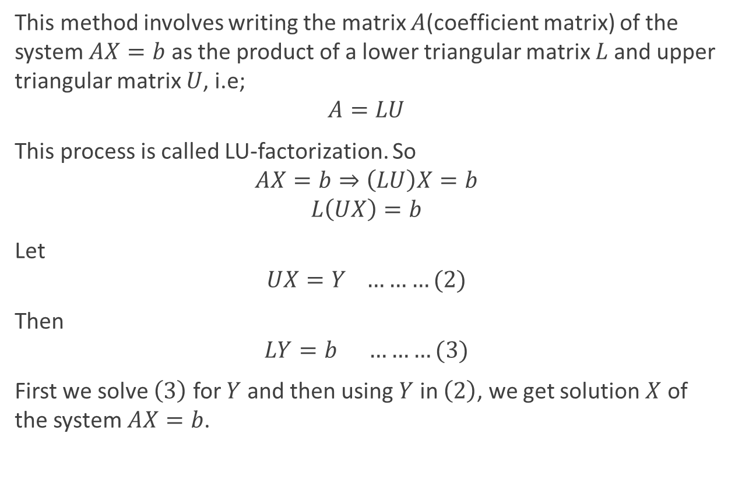
Method of LU Factorization
This method involves writing the matrix $A$(coefficient matrix) of the system $AX=b$ as the product of a lower triangular matrix $L$and upper triangular matrix $U$, i.e;
$$A=LU$$
This process is called LU-factorization. So
$$AX=b⇒\left(LU\right)X=b$$
$$L\left(UX\right)=b$$
Let
$$UX=Y ………(2)$$
Then
$$LY=b ………(3)$$
First we solve $\left(3\right)$ for $Y$ and then using $Y$ in $\left(2\right)$, we get solution $X$ of the system $AX=b$.

Slide 6
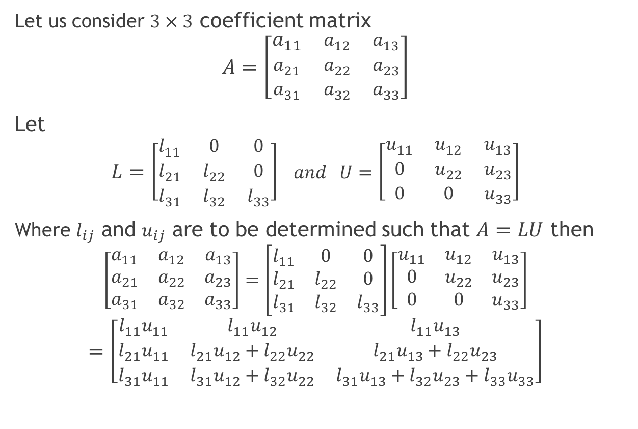
Factorization Of A
Let us consider $3×3$ coefficient matrix
$$A=\left[\begin{matrix}a_{11} & a_{12} & a_{13} \\ a_{21} & a_{22} & a_{23} \\ a_{31} & a_{32} & a_{33}\end{matrix}\right]$$
Let
$$L=\left[\begin{matrix}l_{11} & 0 & 0 \\ l_{21} & l_{22} & 0 \\ l_{31} & l_{32} & l_{33}\end{matrix}\right] and U=\left[\begin{matrix}u_{11} & u_{12} & u_{13} \\ 0 & u_{22} & u_{23} \\ 0 & 0 & u_{33}\end{matrix}\right]$$
Where $l_{ij}$ and $u_{ij}$ are to be determined such that $A=LU$ then
$$\left[\begin{matrix}a_{11} & a_{12} & a_{13} \\ a_{21} & a_{22} & a_{23} \\ a_{31} & a_{32} & a_{33}\end{matrix}\right]=\left[\begin{matrix}l_{11} & 0 & 0 \\ l_{21} & l_{22} & 0 \\ l_{31} & l_{32} & l_{33}\end{matrix}\right]\left[\begin{matrix}u_{11} & u_{12} & u_{13} \\ 0 & u_{22} & u_{23} \\ 0 & 0 & u_{33}\end{matrix}\right]$$
$$=\left[\begin{matrix}l_{11}u_{11} & l_{11}u_{12} & l_{11}u_{13} \\ l_{21}u_{11} & l_{21}u_{12}+l_{22}u_{22} & l_{21}u_{13}+l_{22}u_{23} \\ l_{31}u_{11} & l_{31}u_{12}+l_{32}u_{22} & l_{31}u_{13}+l_{32}u_{23}+l_{33}u_{33}\end{matrix}\right]$$

Slide 7
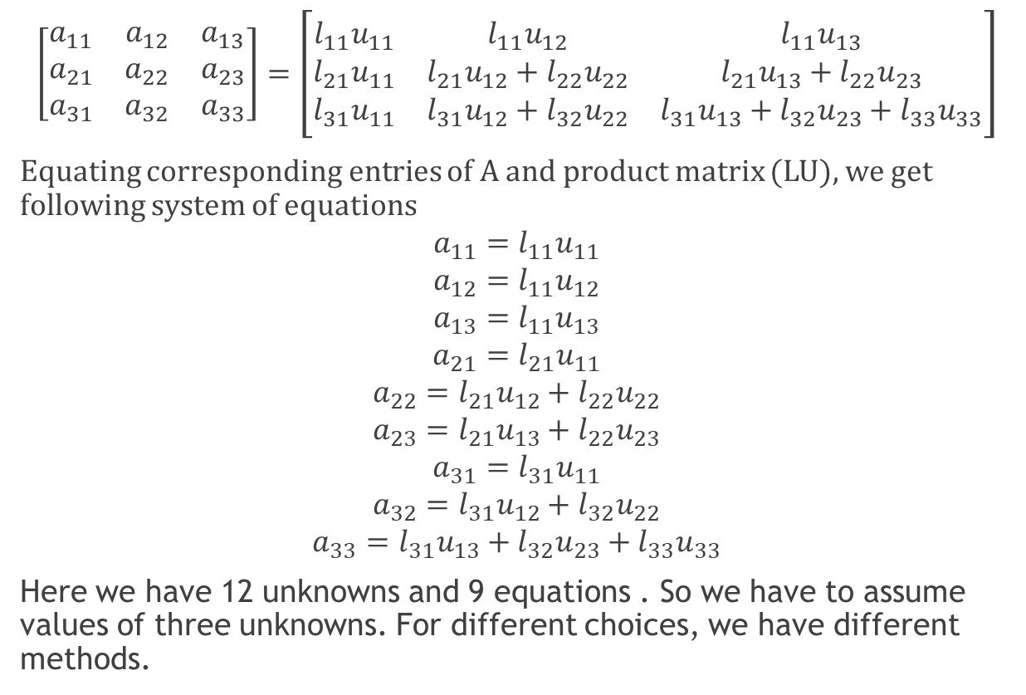
Equating corresponding entries
$$\left[\begin{matrix}a_{11} & a_{12} & a_{13} \\ a_{21} & a_{22} & a_{23} \\ a_{31} & a_{32} & a_{33}\end{matrix}\right]=\left[\begin{matrix}l_{11}u_{11} & l_{11}u_{12} & l_{11}u_{13} \\ l_{21}u_{11} & l_{21}u_{12}+l_{22}u_{22} & l_{21}u_{13}+l_{22}u_{23} \\ l_{31}u_{11} & l_{31}u_{12}+l_{32}u_{22} & l_{31}u_{13}+l_{32}u_{23}+l_{33}u_{33}\end{matrix}\right]$$
Equating corresponding entries of A and product matrix (LU), we get following system of equations
$$a_{11}=l_{11}u_{11}$$
$$a_{12}=l_{11}u_{12}$$
$$a_{13}=l_{11}u_{13}$$
$$a_{21}=l_{21}u_{11}$$
$$a_{22}=l_{21}u_{12}+l_{22}u_{22}$$
$$a_{23}=l_{21}u_{13}+l_{22}u_{23}$$
$$a_{31}=l_{31}u_{11}$$
$$a_{32}=l_{31}u_{12}+l_{32}u_{22}$$
$$a_{33}=l_{31}u_{13}+l_{32}u_{23}+l_{33}u_{33}$$
Here we have 12 unknowns and 9 equations . So we have to assume values of three unknowns. For different choices, we have different methods.
2

Slide 8

1.Doolittle Method
In this method, We assume that
$$l_{11}=l_{22}=l_{33}=1$$
Then system of equations (2) becomes,
$$a_{11}=u_{11}$$
$$a_{12}=u_{12}$$
$$a_{13}=u_{13}$$
$$a_{21}=l_{21}u_{11}$$
$$a_{22}=l_{21}u_{12}+u_{22}$$
$$a_{23}=l_{21}u_{13}+u_{23}$$
$$a_{31}=l_{31}u_{11}$$
$$a_{32}=l_{31}u_{12}+l_{32}u_{22}$$
$$a_{33}=l_{31}u_{13}+l_{32}u_{23}+u_{33}$$
Solving above system, we can determine unknowns.
3

Slide 9

2. Crout Method
In this method, we assume
$$u_{11}=u_{22}=u_{33}=1$$
Then system of equations (2) becomes,
$$a_{11}=l_{11}$$
$$a_{12}=l_{11}u_{12}$$
$$a_{13}=l_{11}u_{13}$$
$$a_{21}=l_{21}$$
$$a_{22}=l_{21}u_{12}+l_{22}$$
$$a_{23}=l_{21}u_{13}+l_{22}u_{23}$$
$$a_{31}=l_{31}$$
$$a_{32}=l_{31}u_{12}+l_{32}$$
$$a_{33}=l_{31}u_{13}+l_{32}u_{23}+l_{33}$$
Solving above system, we can determine unknowns.

Slide 10
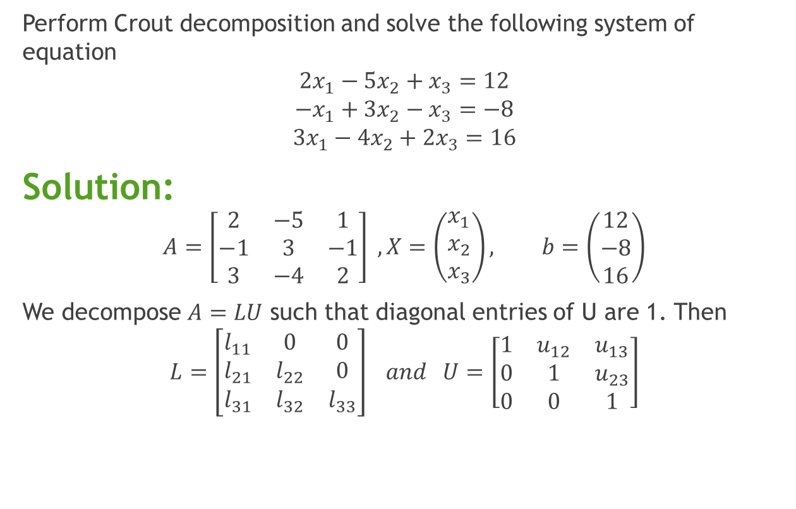
Example
Perform Crout decomposition and solve the following system of equation
$$2x_{1}−5x_{2}+x_{3}=12$$
$$−x_{1}+3x_{2}−x_{3}=−8$$
$$3x_{1}−4x_{2}+2x_{3}=16$$
Solution:
$$A=\left[\begin{matrix}2 & −5 & 1 \\ −1 & 3 & −1 \\ 3 & −4 & 2\end{matrix}\right] , X=\left(\begin{matrix}x_{1} \\ x_{2} \\ x_{3}\end{matrix}\right), b=\left(\begin{matrix}12 \\ −8 \\ 16\end{matrix}\right)$$
We decompose $A=LU$ such that diagonal entries of U are 1. Then
$$L=\left[\begin{matrix}l_{11} & 0 & 0 \\ l_{21} & l_{22} & 0 \\ l_{31} & l_{32} & l_{33}\end{matrix}\right] and U=\left[\begin{matrix}1 & u_{12} & u_{13} \\ 0 & 1 & u_{23} \\ 0 & 0 & 1\end{matrix}\right]$$

Slide 11
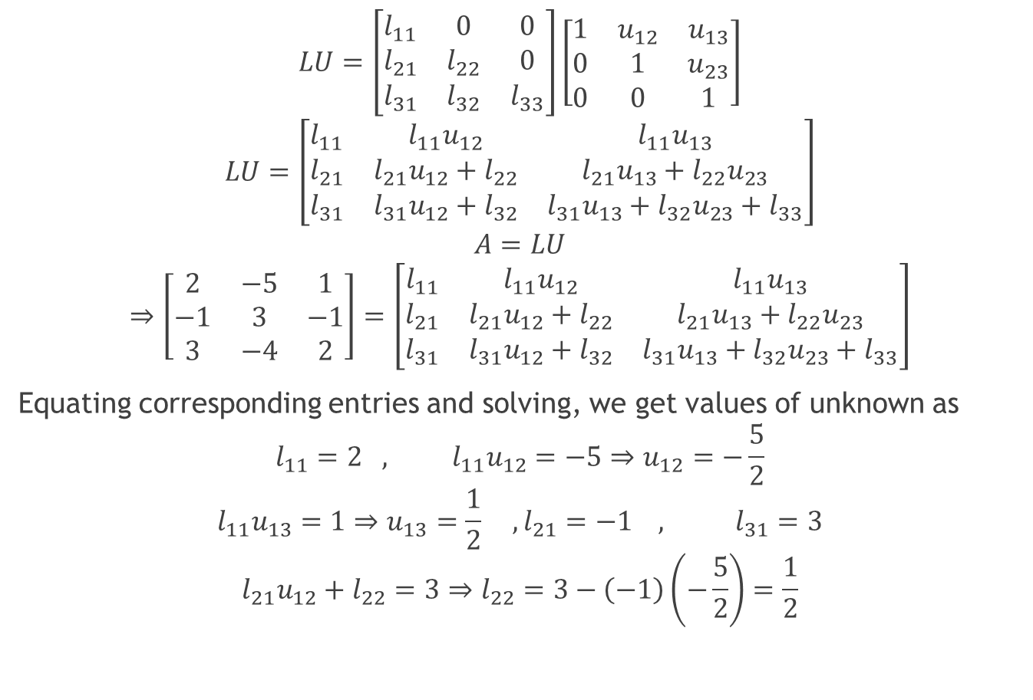
$$LU=\left[\begin{matrix}l_{11} & 0 & 0 \\ l_{21} & l_{22} & 0 \\ l_{31} & l_{32} & l_{33}\end{matrix}\right]\left[\begin{matrix}1 & u_{12} & u_{13} \\ 0 & 1 & u_{23} \\ 0 & 0 & 1\end{matrix}\right]$$
$$LU=\left[\begin{matrix}l_{11} & l_{11}u_{12} & l_{11}u_{13} \\ l_{21} & l_{21}u_{12}+l_{22} & l_{21}u_{13}+l_{22}u_{23} \\ l_{31} & l_{31}u_{12}+l_{32} & l_{31}u_{13}+l_{32}u_{23}+l_{33}\end{matrix}\right]$$
$$A=LU$$
$$⇒\left[\begin{matrix}2 & −5 & 1 \\ −1 & 3 & −1 \\ 3 & −4 & 2\end{matrix}\right]=\left[\begin{matrix}l_{11} & l_{11}u_{12} & l_{11}u_{13} \\ l_{21} & l_{21}u_{12}+l_{22} & l_{21}u_{13}+l_{22}u_{23} \\ l_{31} & l_{31}u_{12}+l_{32} & l_{31}u_{13}+l_{32}u_{23}+l_{33}\end{matrix}\right]$$
Equating corresponding entries and solving, we get values of unknown as
$$l_{11}=2 , l_{11}u_{12}=−5⇒u_{12}=−\frac{5}{2}$$
$$l_{11}u_{13}=1⇒u_{13}=\frac{1}{2} ,l_{21}=−1 , l_{31}=3$$
$$l_{21}u_{12}+l_{22}=3⇒l_{22}=3−\left(−1\right)\left(−\frac{5}{2}\right)=\frac{1}{2}$$
1

Slide 12

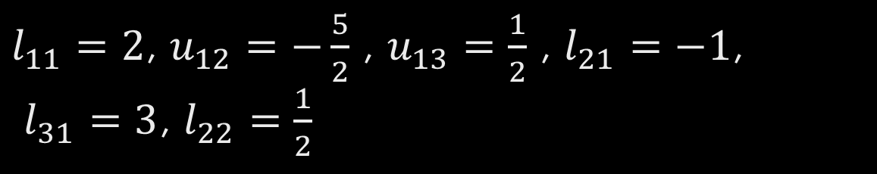
$l_{11}=2$, $u_{12}=−\frac{5}{2}$ , $u_{13}=\frac{1}{2}$ , $l_{21}=−1$, $l_{31}=3$, $l_{22}=\frac{1}{2}$
$$l_{21}u_{13}+l_{22}u_{23}=−1⇒u_{23}=2\left(−1−\left(−1\right)\left(\frac{1}{2}\right)\right)=−1$$
$$l_{31}u_{12}+l_{32}=−4⇒l_{32}=−4−3\left(−\frac{5}{2}\right)=\frac{7}{2}$$
$$l_{31}u_{13}+l_{32}u_{23}+l_{33}=2$$
$$⇒l_{33}=2−3\left(\frac{1}{2}\right)−\frac{7}{2}\left(−1\right)=2−\frac{3}{2}+\frac{7}{2}=4$$
Thus
$$L=\left[\begin{matrix}2 & 0 & 0 \\ −1 & 1/2 & 0 \\ 3 & 7/2 & 4\end{matrix}\right] , U=\left[\begin{matrix}1 & −5/2 & 1/2 \\ 0 & 1 & −1 \\ 0 & 0 & 1\end{matrix}\right]$$

Slide 13

Method of LU Factorization
This method involves writing the matrix A(coefficient matrix) of the system $AX=b$ as the product of a lower triangular matrix $L$and upper triangular matrix $U$, i.e;
$$A=LU$$
This process is called LU-factorization. So
$$AX=b⇒\left(LU\right)X=b$$
$$L\left(UX\right)=b$$
Let
$$UX=Y ………(2)$$
Then
$$LY=b ………(3)$$
First we solve $\left(3\right)$ for $Y$ and then using $Y$ in $\left(2\right)$, we get solution $X$ of the system $AX=b$.

Slide 14

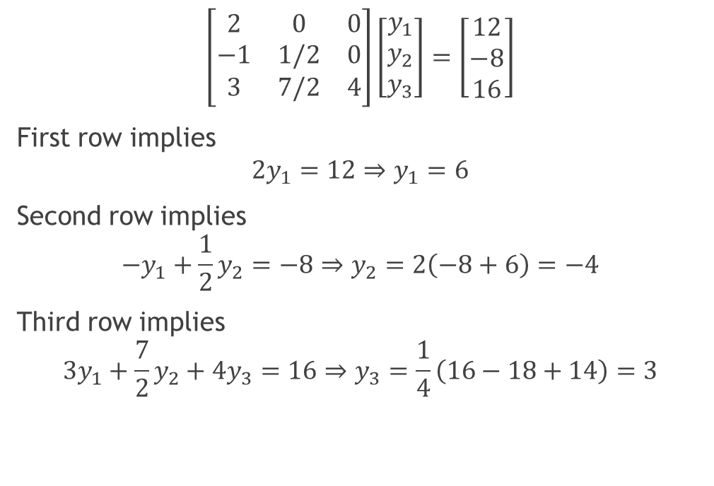

Solving $LY=b$
$$\left[\begin{matrix}2 & 0 & 0 \\ −1 & 1/2 & 0 \\ 3 & 7/2 & 4\end{matrix}\right]\left[\begin{matrix}y_{1} \\ y_{2} \\ y_{3}\end{matrix}\right]=\left[\begin{matrix}12 \\ −8 \\ 16\end{matrix}\right]$$
First row implies
$${2y}_{1}=12⇒y_{1}=6$$
Second row implies
$$−y_{1}+\frac{1}{2}y_{2}=−8⇒y_{2}=2\left(−8+6\right)=−4$$
Third row implies
$$3y_{1}+\frac{7}{2}y_{2}+4y_{3}=16⇒y_{3}=\frac{1}{4}\left(16−18+14\right)=3$$
Thus
$$\left[\begin{matrix}y_{1} \\ y_{2} \\ y_{3}\end{matrix}\right]=\left[\begin{aligned}6 \\ −4 \\ 3\end{aligned}\right]$$

Slide 15


Solving $UX=Y$
$$\left[\begin{matrix}1 & −5/2 & 1/2 \\ 0 & 1 & −1 \\ 0 & 0 & 1\end{matrix}\right]\left[\begin{matrix}x_{1} \\ x_{2} \\ x_{3}\end{matrix}\right]=\left[\begin{aligned}6 \\ −4 \\ 3\end{aligned}\right]$$
Third row implies $x_{3}=3$
Second row implies $x_{2}−x_{3}=−4⇒x_{2}=−1$
First row implies $x_{1}−\frac{5}{2}x_{2}+\frac{1}{2}x_{3}=6⇒x_{1}=6−\frac{5}{2}−\frac{3}{2}=2$
Thus solution of given system is
$$\left[\begin{matrix}x_{1} \\ x_{2} \\ x_{3}\end{matrix}\right]=\left[\begin{aligned}2 \\ −1 \\ 3\end{aligned}\right]$$
To verify: Put above solution in given system. If every equation is satisfied then solution is correct.

Slide 16
Home Exercises
Perform Doolittle decomposition and solve the system of equation given in above example.

